Slide 1
The “full stack” for SharePoint developers
Paul Galvin
Galvin.paul@gmail.com
@pagalvin
https://www.gitbook.com/@pagalvin

Slide 2
Agenda
About the speaker
Super basics: HTML, CSS, JavaScript
Advanced Basics: VS Code, SCSS, Responsive Web Design (RWD) & TypeScript
Task Runners
Frameworks & Scaffolding
Node & NPM
Wrap and next steps
Optimized deployment

Slide 3
About the speaker
Paul Galvin
Slalom Consulting
@pagalvin on the twitter machine
https://medium.com/@pagalvin
https://github.com/pagalvin/office365BootcampOct2017

Slide 4

Why talk about super basics?
I’ll be quick, but …
Some non-developers attend these events
Some developers don’t do front end coding
Some devs barely do any front-end coding and it can’t hurt to make sure we’re all on the same page

Slide 5

Super Basics – HTML, CSS and JavaScript
HTML = “hypertext markup language”
Spec’d out in 1990
“written” in 1991
HTML “tags” that include elements and attributes
These are instructions to a web browser on how to render a page
“page” oriented and all the bits collectively called the “DOM”
Demo
Notes:
Do a quick demo of creating an html file using notepad

Slide 6
Fun fact!
.gif pronounced as … ?
<div> tag stands for “division”
https://www.w3.org/TR/REC-html32#block

Slide 7
Super Basics – HTML, CSS and JavaScript
CSS = “cascading style sheets”
Were kind of always there, but first “regular” CSS introduced in 1994
CSS enables us to separate content (html) from presentation
Control fonts,
Demo!

Slide 8

Super basics - javascript
What is JavaScript?
Machine language of the web – every web browser that we care about runs JavaScript
Written in 10 days in 1995 by …
It’s not Java
Runs in a web browsers by web browsers
Is destroyed every time the user presses F5, closes the browser or clicks on a link that brings them to a new page – it’s vengefully stateless
These days, it’s mature, robust and actively managed by the Ecma International people
Notes:
Written by Brendan Eich

Slide 9
Super Basics – more on javascript
It’s a prototype basic language that …
Feels a lot like an OO language (especially when we get into TypeScript)
Is very functional in the FP sense of the word
It’s wildly popular
Complex, deep frameworks have been developed for it and by it
In use world-wide
It’s an evolving language
“ECMAScript”
Used to evolve verrrrrry slow. Faster now. Latest update this past June.
Demo!

Slide 10

Advanced basics – VS Code, scss, rwd and typescript
Visual Studio is the premier best-in-world IDE for developing enterprise class applications
But …
VS Code is the new coolness
It works and supports the way all the kids these days like to work
Demo!

Slide 11
Advanced basics – VS Code, scss, rwd and typescript
SCSS = “sassy CSS”
Supports some dynamic features and layers them on top of CSS
Variables
Looping
SCSS “compiles down” to plain CSS
No web browser (that we’ll use anyway) natively supports SCSS
Plain CSS is valid SCSS, so SPFx uses it by default
Wondering if SCSS introduces complexity into your build process?

Slide 12


Slide 13
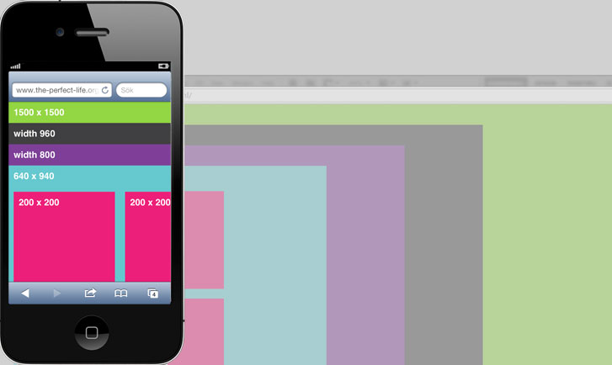
Advanced basics – VS Code, scss, rwd and typescript
RWD = “responsive web design”
It’s not about performance
It’s about web pages responding to a view port
RWD has given rise to CSS frameworks, believe it or not
Bootstrap
Ionic
Many others

Slide 14
RWD Demo!
You’ve seen it many times
www.nytimes.com
A little site, www.slalom.com ☺

Slide 15
Advanced basics - typescript
Completely new language
Five years old
Developed by Microsoft
Type = “types” = “strongly typed” language
Transpilation required
Write your TS code
Transpile it to plain JS
Deploy and run

Slide 16
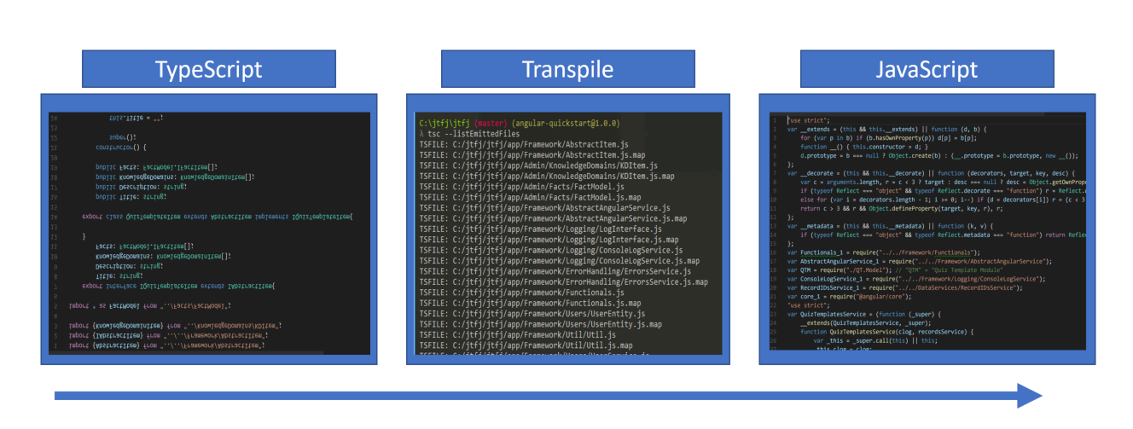
Typescript – flow and demo!

Slide 17
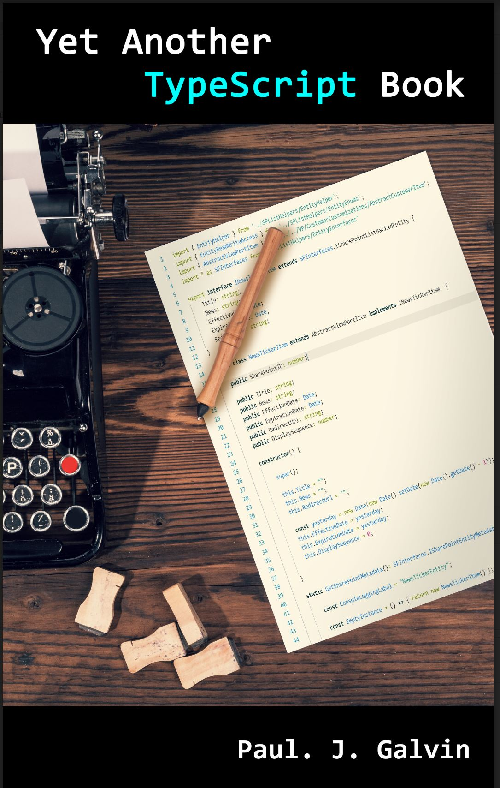
Typescript Book!
I wrote a book!
It’s free!
Yet Another TypeScript Book
https://pagalvin.gitbooks.io/yet-another-typescript-book/content/

Slide 18
Node and NPM
Node
Headless JavaScript
JavaScript engine without the DOM
Very popular tool
Means you can write server-side applications in JavaScript

Slide 19
Node and npm
NPM = “node package manager”
Anyone can write a bit of code and register it up on the node registry
A lot of people do this
Too many people

Slide 20
Node Package manager and package.json
Your client-side projects will usually pull down a lot of modules
Note that a node module can and often does run in a browser – npm is just a convenient registry
A client side “project” is usually a directory on your hard drive with a bazillion sub-directories
The code itself is generally backed up in source code control repository. The kids these days tend to use GitHub.
No good reason to save node modules in your SCC system
Package.json maintains pointers to the node modules
“npm install” parses package.json to download any required node modules
Package.json *is* saved in your SCC system
Notes:
Explain how a new dev comes on board, they pull down the source code and then run “npm install”. This downloads all the stuff needed from the npm registry

Slide 21

Task runners
These days, the edit/save/build/deploy process is complex
Task runners enable us to automate all these things:
Compile SCSS
Transpile TS to JS
Do syntax checks and linting
Run unit tests
Deploy to SharePoint
And others

Slide 22
Task Runners
Most popular task runner today (currently) is …
Gulp
A “task” is some JavaCcript code that executes
Runs in Node
Can watch for file changes
Is itself download via NPM

Slide 23
Frameworks and scaffolding
No one can write an enterprise or even moderately complex JS solution “from scratch” these days
Server-side design patterns are well established and in use
Client-side has its own challenges (not least of which is ruthlessly stateless nature of the web)
This has given rise to frameworks
Microsoft is betting on React

Slide 24
Frameworks and scaffolding
Frameworks are awesome!
But they are complex
JS community has developed “project starter packs” based on their frameworks.
This is called “scaffolding”
It’s the act of setting up a baseline project with sensible initial configuration and options
In theory, you can focus on coding and less on the framework
Microsoft has chosen Yoeman
Many people use Node too
This is very similar to what happens when you create a new project in Visual Studio

Slide 25
Deployment
You end up with a lot of discrete files
All of these elements get downloaded to clients and in the case of JavaScript, must be downloaded in the right order
An efficient web site …
Reduces total number of discrete downloads
Minimizes size of downloaded content
Webpack + task runner makes this happen

Slide 26

Putting it all together
HTML
CSS
JavaScript
TypeScript
Frameworks
Scaffolding
Task Runners
Node

Slide 27
Where do I go from here?
It can be overwhelming
The good news is
This stuff is really, really popular
A lot of it is very well tested and reliable
Many tutorials out there
Suggestions
Sit in on my next session!
Read my book! ☺
Go home and try out the SPFx “hello world” web part. It uses a lot of these tools. It doesn’t give much context, but it does give you a practical tutorial to follow.
Fight the good fight.

Slide 28
Last Word
Microsoft has bet big on client side dev
SharePoint online is kind of the future for them
There is no server-side dev going on there
Server-side dev is not dead and won’t be dead
But all the new coolness is, in the near future, being built O365, not on-prem
Don’t get clobbered by today’s SP-ignorant but skilled full stack devs
https://hackernoon.com/are-todays-sharepoint-developers-in-jeopardy-cd4e9a11ad69

